Slide 1
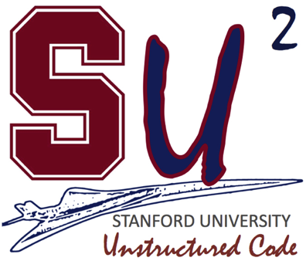
Welcome and introduction to SU²
SU² Release Version 2.0 Workshop
Stanford University
Tuesday, January 15th, 2013
Dr. F. Palacios and Prof. J. J. Alonso
Department of Aeronautics & Astronautics
Stanford University
SU² Development Team: J. J. Alonso, F. Palacios, K. Duraisamy, M. R. Colonno, A. C. Aranake, A. Campos, S. R. Copeland, T. D. Economon, A. K. Lonkar, T. W. Lukaczyk, T. W. R. Taylor

Slide 2
Outline
Motivation
Why SU²?
Current capabilities
Conclusions

Slide 3
Outline
Motivation
Why SU²?
Current capabilities
Conclusions

Slide 4
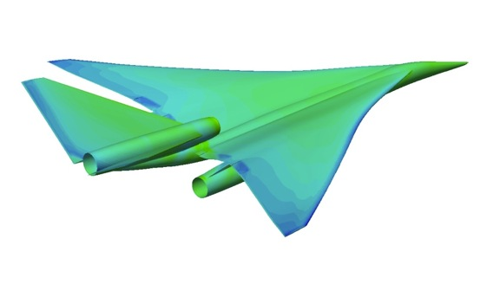
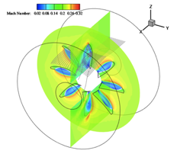
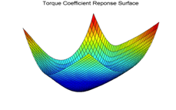
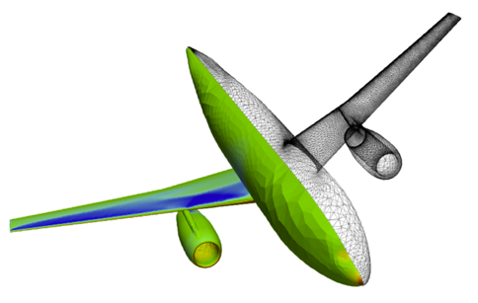
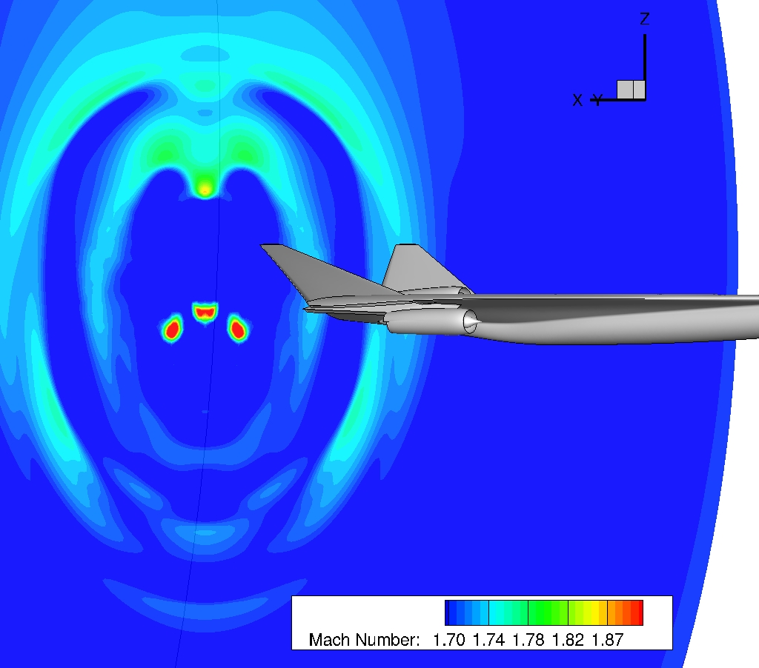
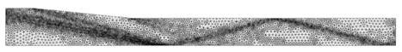
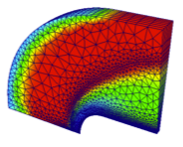
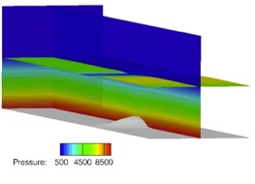
Motivation Our objective
Develop advanced design environments to enable systems that address the challenge of meeting the demand while minimizing the impact on the environment.
Develop a leading solver in the unstructured CFD community

Slide 5
Motivation Multi-Disciplinary Shape Design Optimization
Optimization techniques are the final goal of all practical design project but they are not used everywhere because:
The optimization of a complete aircraft configuration implies the interaction of a lot of different SW modules.
It is not easy to parameterize appropriately the geometry modifications (intersections and geometric constraints).
An optimizer is limited to considering those designs that are described by the selected parameterization.
Important mathematical difficulties in the gradients evaluation.
Great time and personnel resources are typically needed.

Slide 6
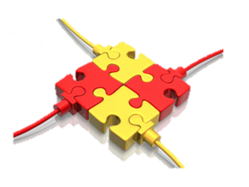
Motivation Software integration in shape design
To integrate the existing SW packages into coupled multi-physics analysis and design optimization solvers is a challenge.
The variety of approaches chosen for the independent components of the overall problem make it difficult to:
Expand the range of applicability to situations not originally envisioned.
Reduce the overall burden of creating integrated applications.
Exploit fully coupled approaches.

Slide 7
Outline
Motivation
Why SU²?
Current capabilities
Conclusions

Slide 8
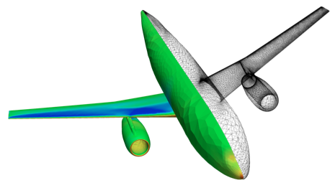
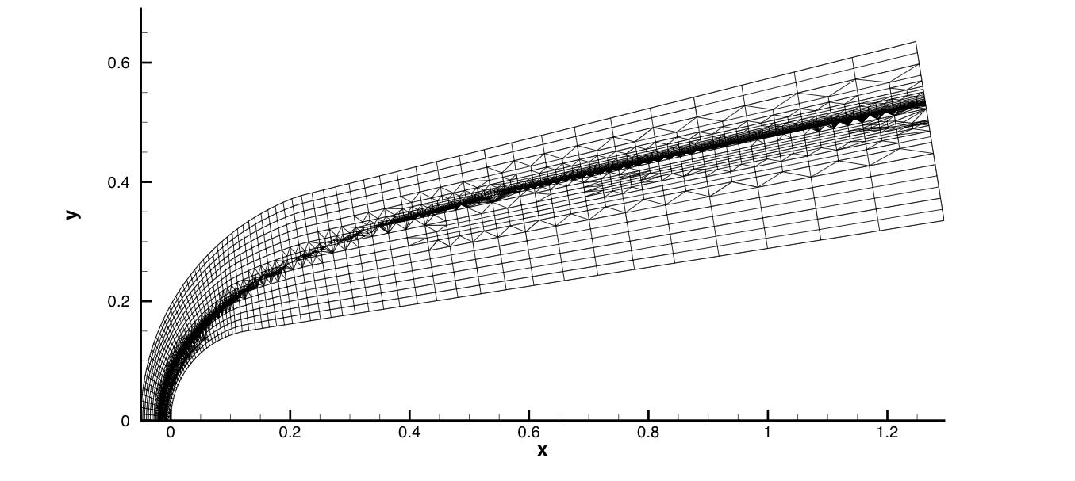
Why SU²? Stanford University Unstructured (SU²) suite
The Stanford University Unstructured (SU²) suite is an open-source collection of C++ based software tools to perform PDE analysis and solve PDE-constrained optimization problems.
SU² is under active development at Stanford University in the Aerospace Design Lab (ADL) of the Department of Aeronautics and Astronautics.
More than 24,000 visits and 3,150 downloads since January 19, 2012
http://su2.stanford.edu/

Slide 9
Why SU²? Lasting infrastructure for future efforts
An open-source model: basic formulation with a reasonable set of initial capabilities, we would like to see contributions from the community!
Portability: SU² has been developed using ANSI C++ and only relies on widely-available, well-supported, open-source software.
Reusability and encapsulation: SU² is built so that the main concepts (geometry, sol. algorithms, num. algorithms, etc) are abstracted to a very high-level. This abstraction promotes reusability of the code and enables modifications without incorrectly affecting other portions of the suite.
Flexibility required to re-purpose existing software for new and different uses. Enabling a common interface for all the necessary components.
Performance: we have attempted to develop numerical solution algorithms that result in high-performance convergence of the solver in SU².
Gradient availability: for many applications it is important to obtain grad. of the responses computed by SU² to variations of design parameters.

Slide 10
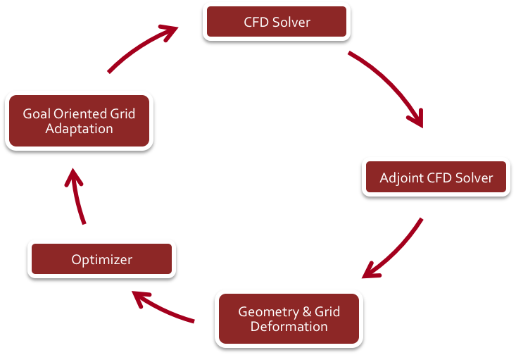
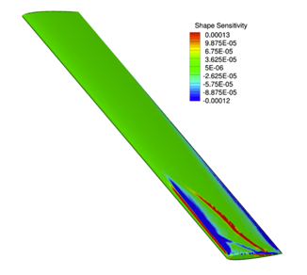
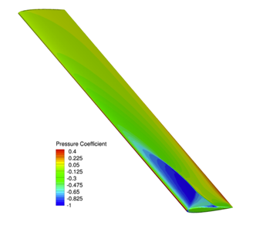

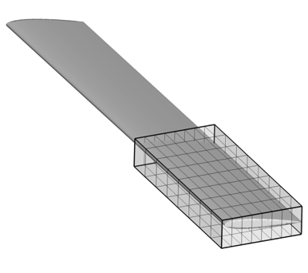
Why SU²? Multi-physics shape optimization.
Shape Optimization
Self-contained optimization env.
Gradient computation using adjoint approach.
3D design variable definition and built-in geometry and mesh deformation.
Torque Sensitivity to Shape Deformations
Pressure Coefficient
Torque Coefficient Response Surface
Multi-Physics Simulations
Simultaneous analysis of different equation sets with tight coupling.
Free surface simulations, noise, fluid structure, etc.
Multi-species plasma solver for simulating ionized flows.

Slide 11
Outline
Motivation
Why SU²?
Current capabilities
Conclusions

Slide 12
Current capabilities High fidelity analysis (I/II)
Verification and Validation is critical.
It should address the consistency of the numerical methods, the accuracy assessment for different critical application cases, and sensitivity studies with respect to parameters.
Compressible RANS simulation.
Rotating frame simulations.
Supersonic simulations.
Low-Mach simulations.
Time-accurate, unsteady simulation.
Free-surface simulation.
Plasma simulation.

Slide 13
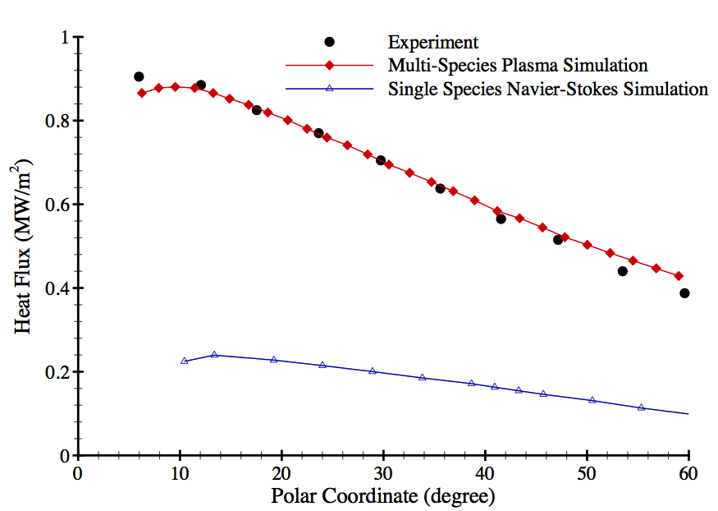
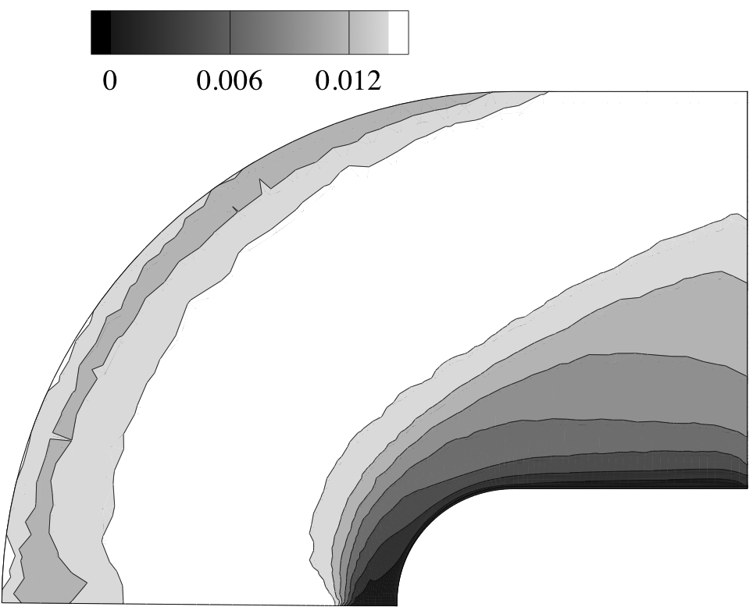
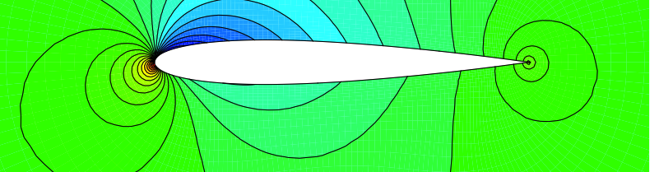
Current capabilities High fidelity analysis (II/II)

Slide 14
Current capabilities Optimal shape design and optimization (I/II)
Torque Sensitivity to Shape Deformations
The design optimization of PDE constrained systems is a primary function of SU².
The built-in adjoint solver in the CFD module, in conjunction with GPC, and MDC deliver objective function gradients.
Pressure Coefficient
Torque Coefficient Response Surface
Supersonic aircraft design.
Airfoil and fixed wing optimization.
Viscous (RANS) design.
Unsteady design.
Nested Free-Form Deformation boxes.

Slide 15
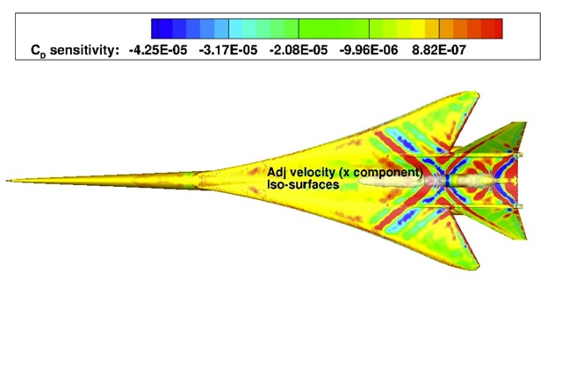
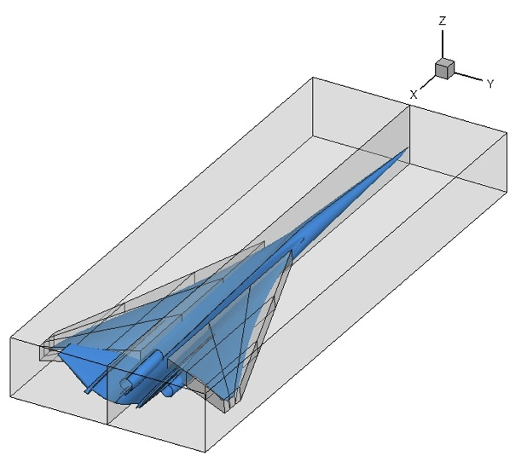
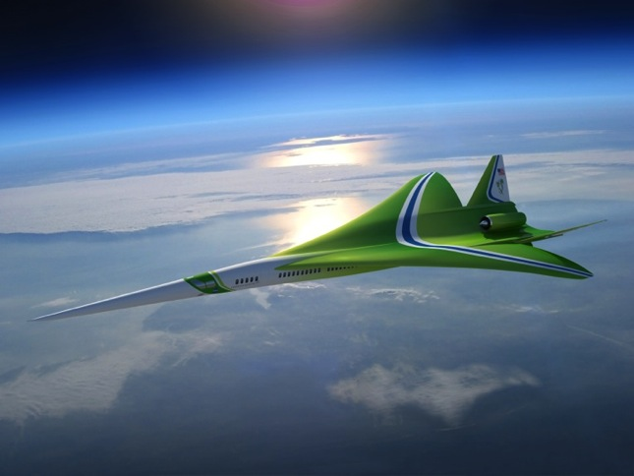
Current capabilities Optimal shape design and optimization (II/II)
Magnitude of surface sensitivity is related to changes in cost function caused by changes in geometry.
Designers can use this sensitivity information to determine appropriate parameterizations of the configuration prior to optimization.
Drag objective function
Mach number = 1.7
AoA = 2.1
Free-stream pressure = 11665.9 Pa
Free-stream temperature = 216.65 K
Fan face Mach 0.515
Total nozzle temp 569.7 K
Total nozzle pressure 109764.5 Pa

Slide 16

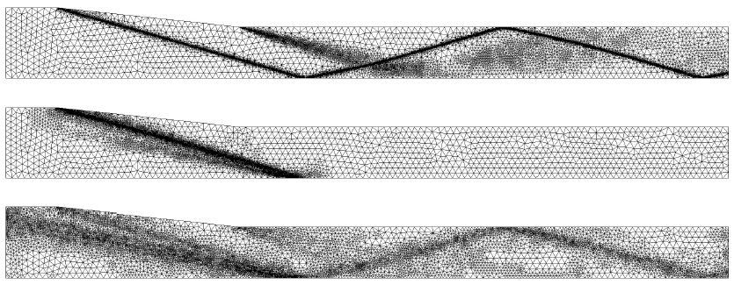
Current capabilities Adaptive mesh refinement (I/II)
The Mesh Adaptation Code in the SU² suite facilitates strategic mesh adaptation based on several common schemes, including gradient and goal-oriented methods.
Goal-oriented mesh adaptation.
Engine propulsion effect adaptation.
Plasma adaptation.
Gradient based
Adjoint based
Robust adaptation

Slide 17
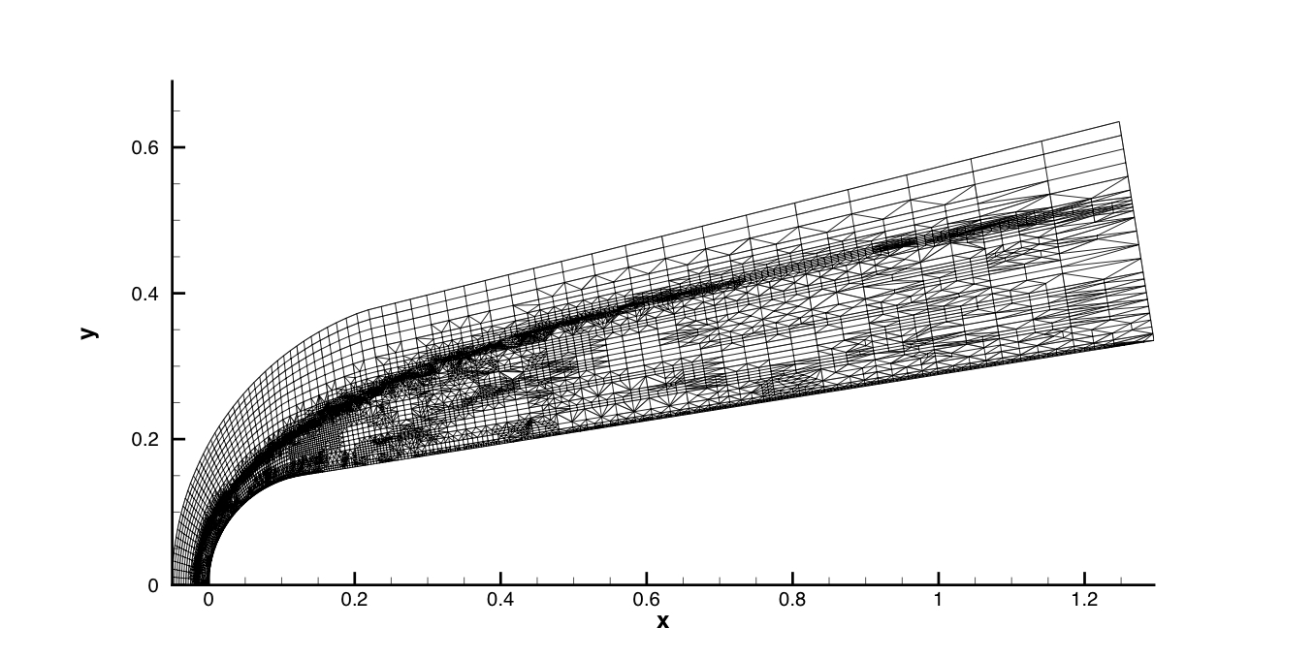
Current capabilities Adaptive mesh refinement (II/II)
Goal oriented adaptation
Grid adaptation
Plasma equations
Two-species Nitrogen gas chemistry model (M = 25.9, H = 71km, T = 216K, and Re = 6280)
Gradient based adaptation
Baseline solution
Goal oriented adaptation
Gradient based adaptation

Slide 18
Outline
Motivation
Why SU²?
Code structure
Current capabilities
Conclusions

Slide 19
Conclusions and future work Analyze, optimize, design!
Thanks to its data structure, SU² is an ideal vehicle for performing multi-physics simulations, including multi-species thermochemical non-equilibrium flow analysis, combustion modeling, two-phase flow simulations, magneto-hydrodynamics simulations, etc.
The optimization of PDE constrained systems is a primary function of the SU² suite.
SU² has been released under an open-source license and it is freely available to the community. Developers around the world can contribute to and improve the suite.
Significant efforts were directed at the development of documentation so that prospective users could get up to speed with a minimum effort.

Slide 20
Conclusions and future work Workshop agenda

Slide 21
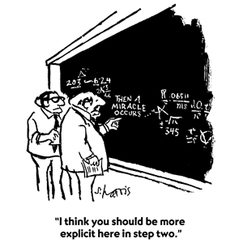
Thank you for your attention!
Your feedback is very important for us!
http://www.cfd-online.com/Forums/su2/
Questions? su2.stanford.edu

